Slide 1

Self Introduction

Slide 2
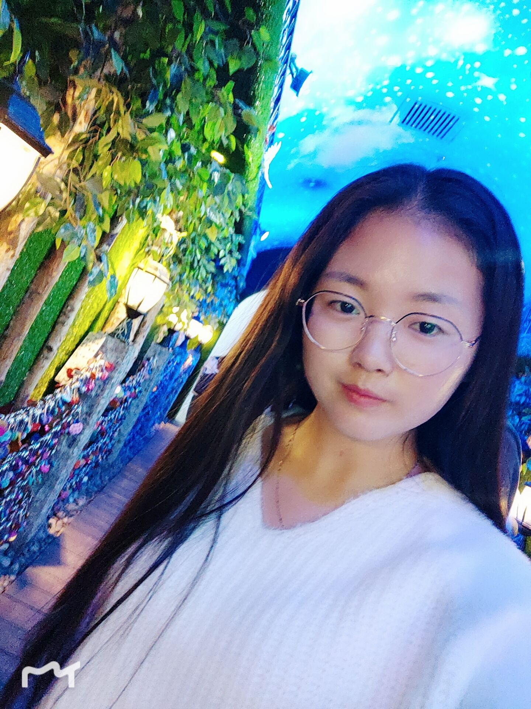
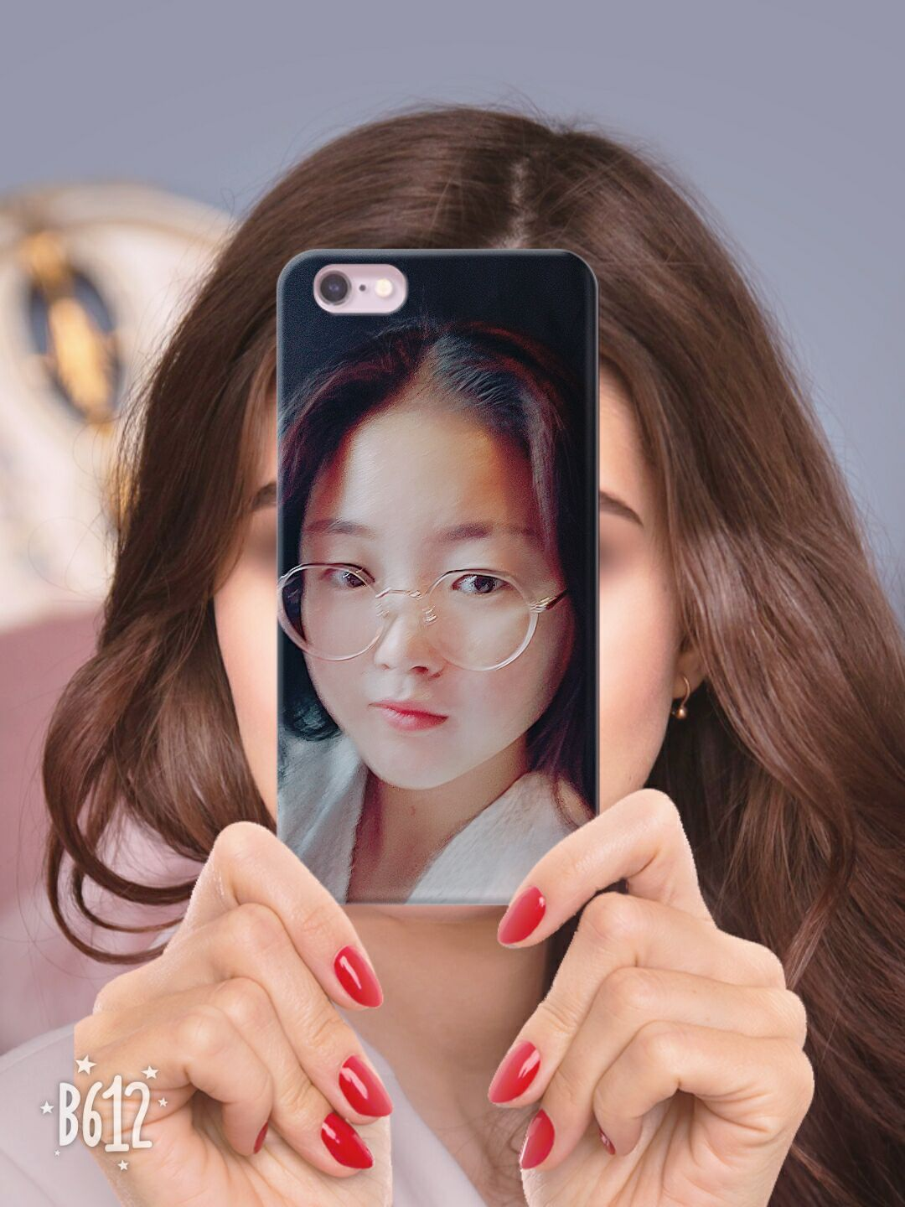
Myself
Hello ! I am Dreamy. This is me, Next let me introduce myself to you.
ヾ(❀^ω^)ﾉﾞ

Slide 3
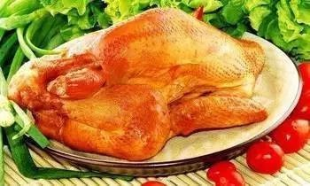
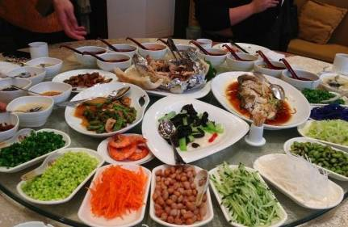
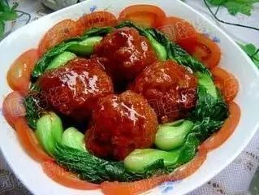
My hometown
Next you will see my hometown. Which is a place has many good foods.
ヾ(❀^ω^)ﾉﾞ

Slide 4
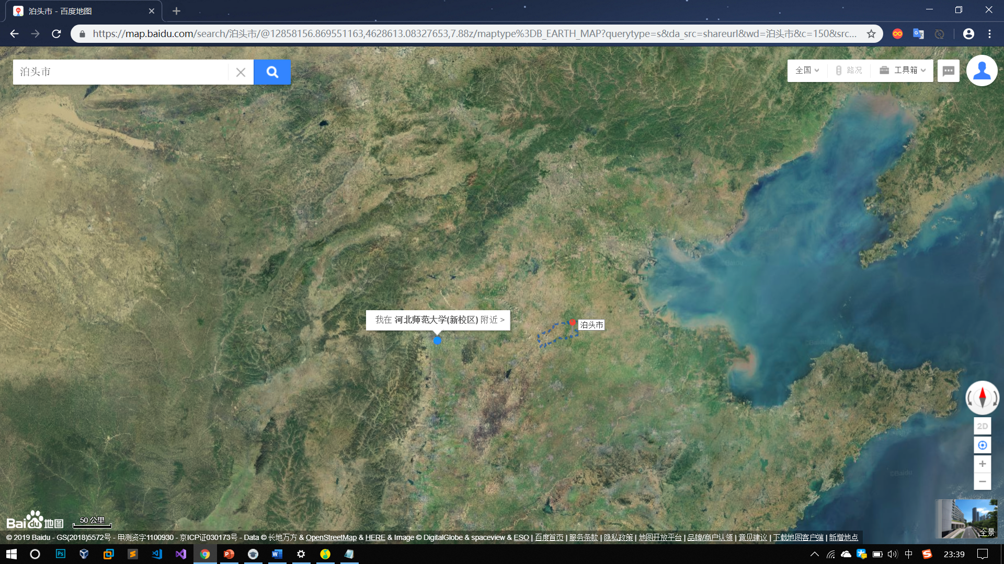
My hometown
This is my hometown, Botou City, Cangzhou City, Hebei Province.

Slide 5
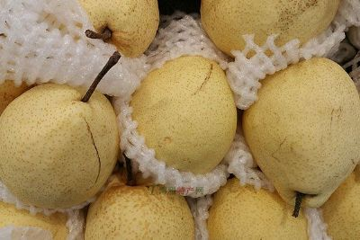
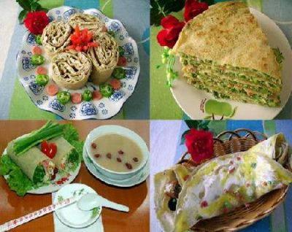
There are many delicious foods in Botou City, Cangzhou City, Hebei Province.
Yali Pear,which is a kind of pear grown in Hebei Province
Jiaohe pancake: This food is called “Jiaohejianbing” in Chinese. It is very delicious.
(～￣▽￣)～

Slide 6
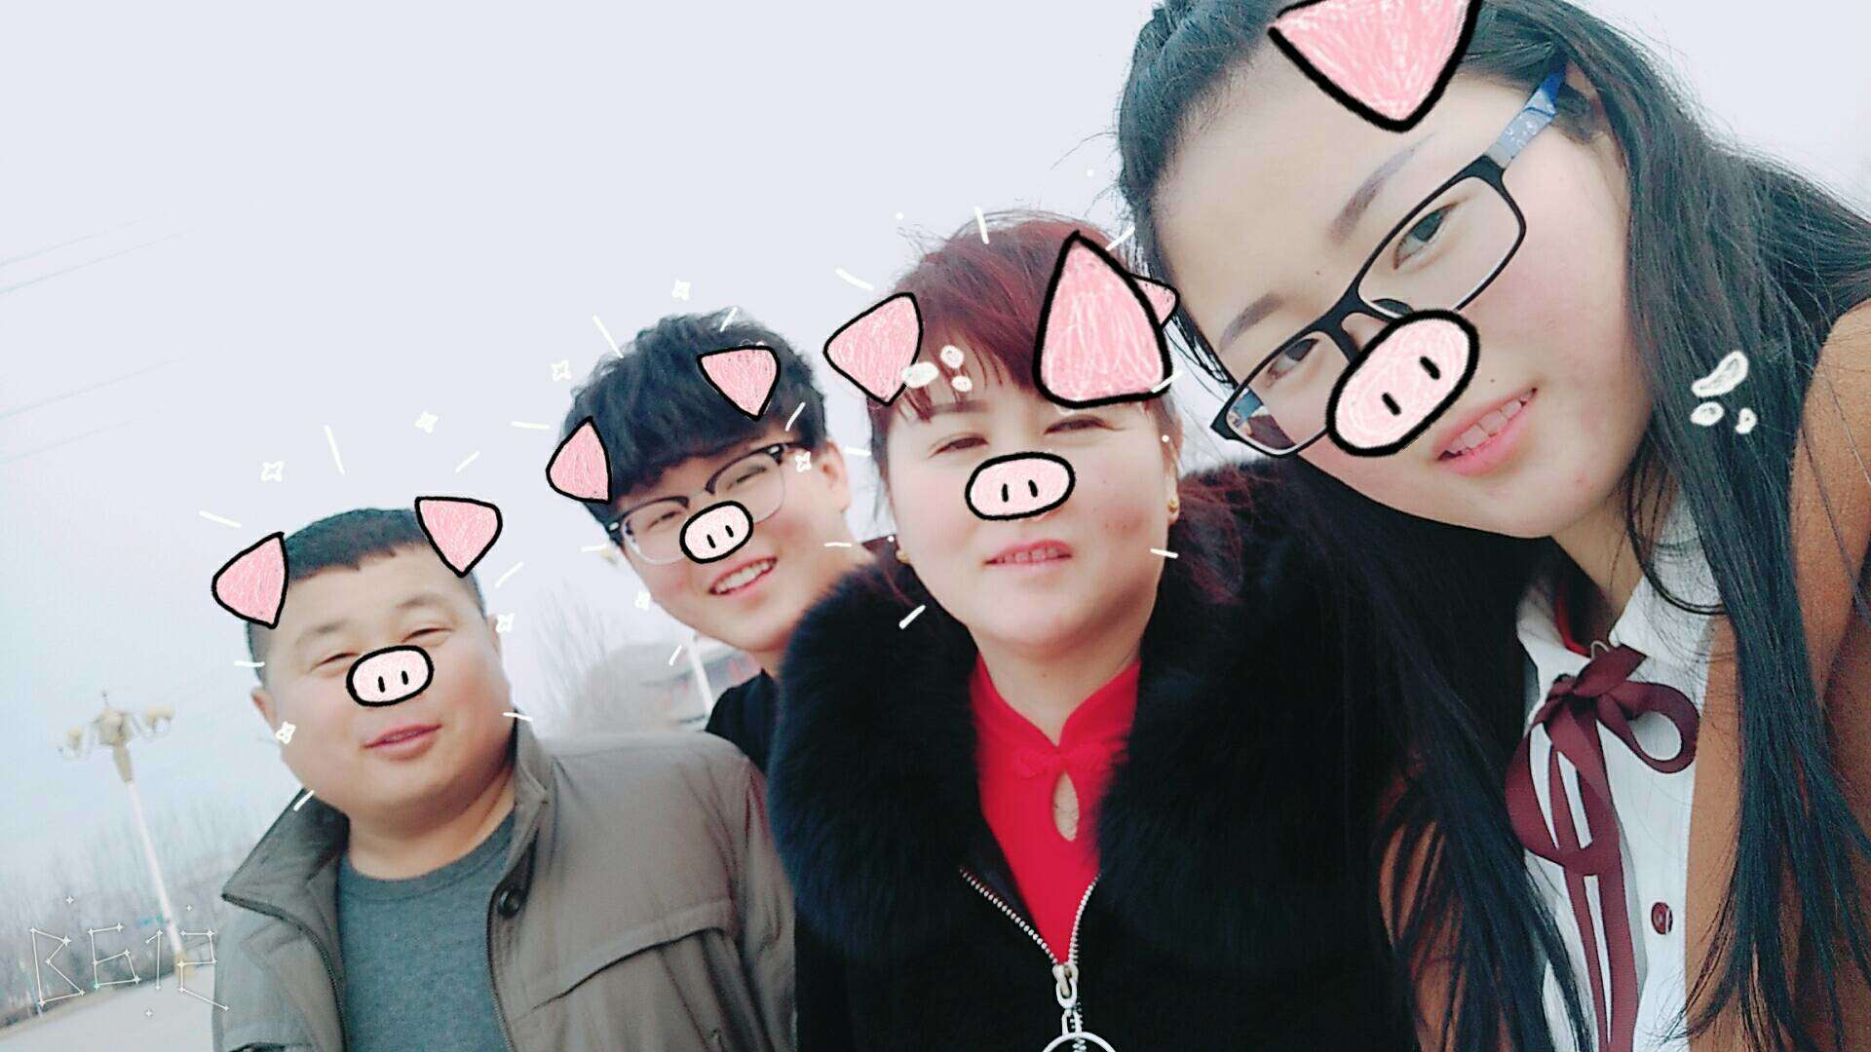
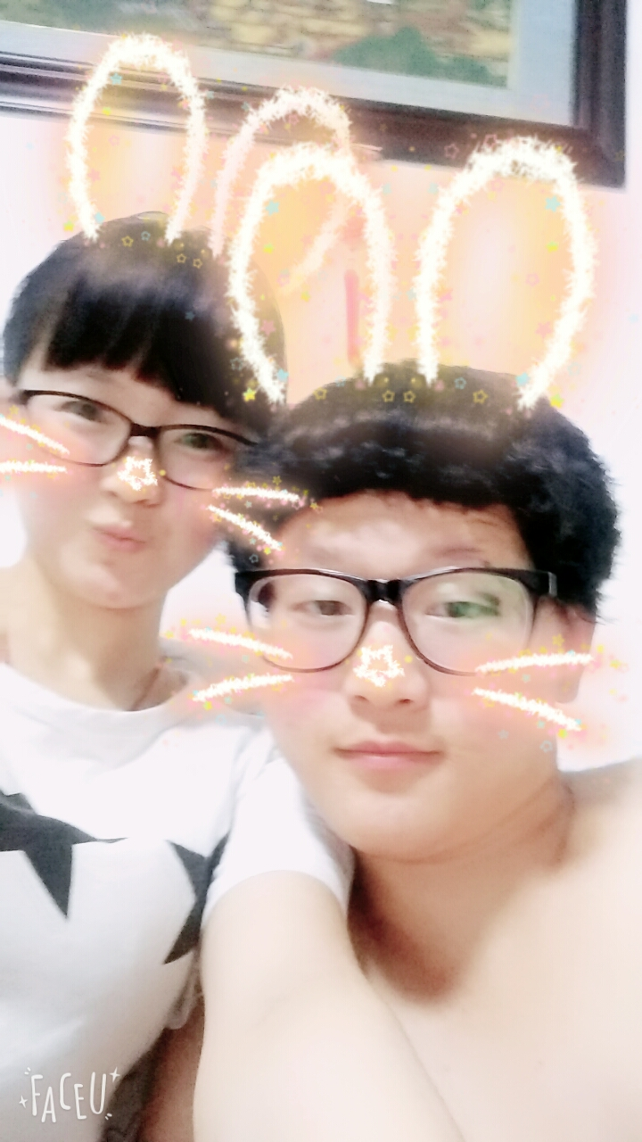
My family
This is my family： my lovely mother, my strong father and my narcissistic brother. I sincerely love my family, home is my eternal harbour, is my most precious thing.
I am a girl who loves her family very much. No matter where I am, my family and my family will always be the most concerned in my heart.

Slide 7
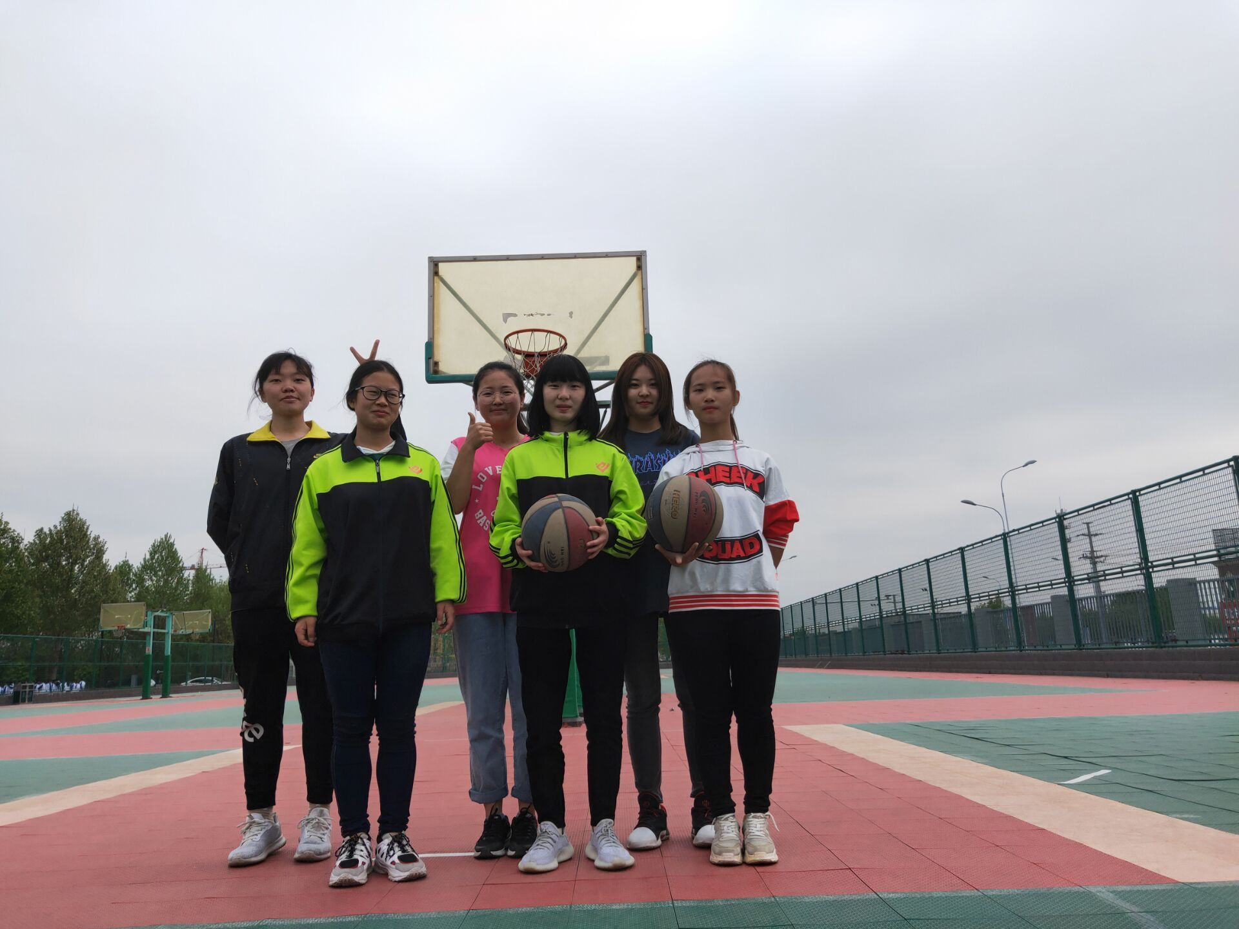
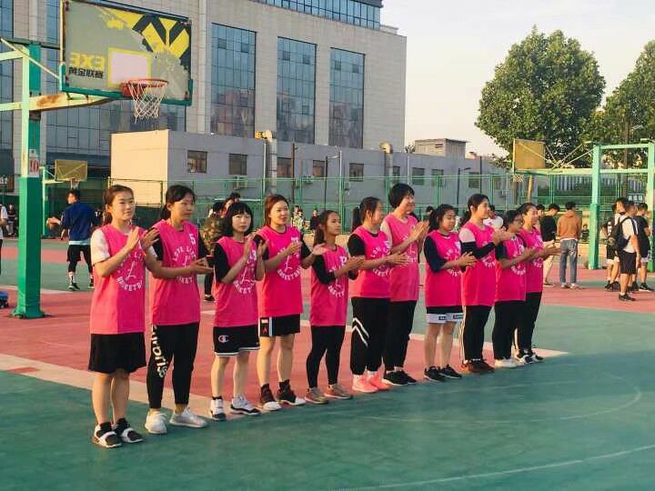
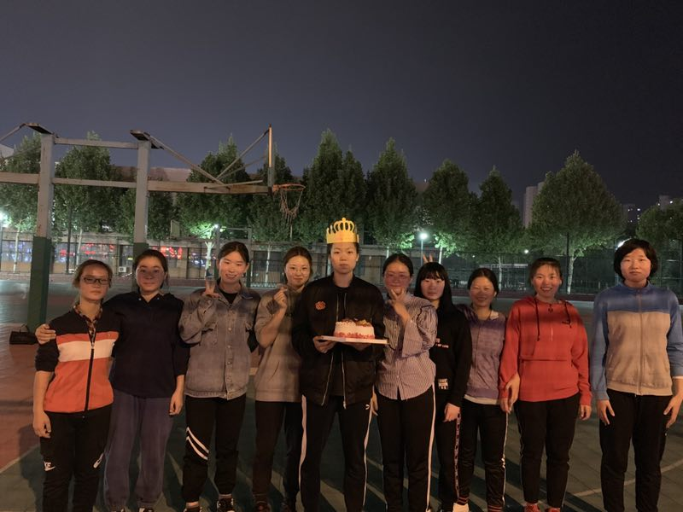
My hobby
Basketball and Friends
My greatest interest is basketball. I really love basketball. That's what makes me the captain of the women's basketball team of the Software Institute. I love this position and I'm faithful to it.
I like basketball very much. Because of this I make many good friends,we often play the basketball together.
(*^▽^*)

Slide 8
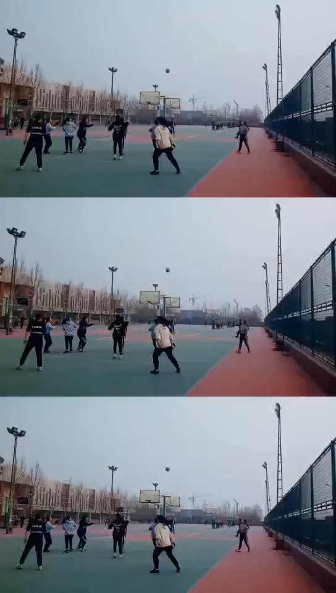
Basketball training
This is our training video. Please enjoy it.

Slide 9
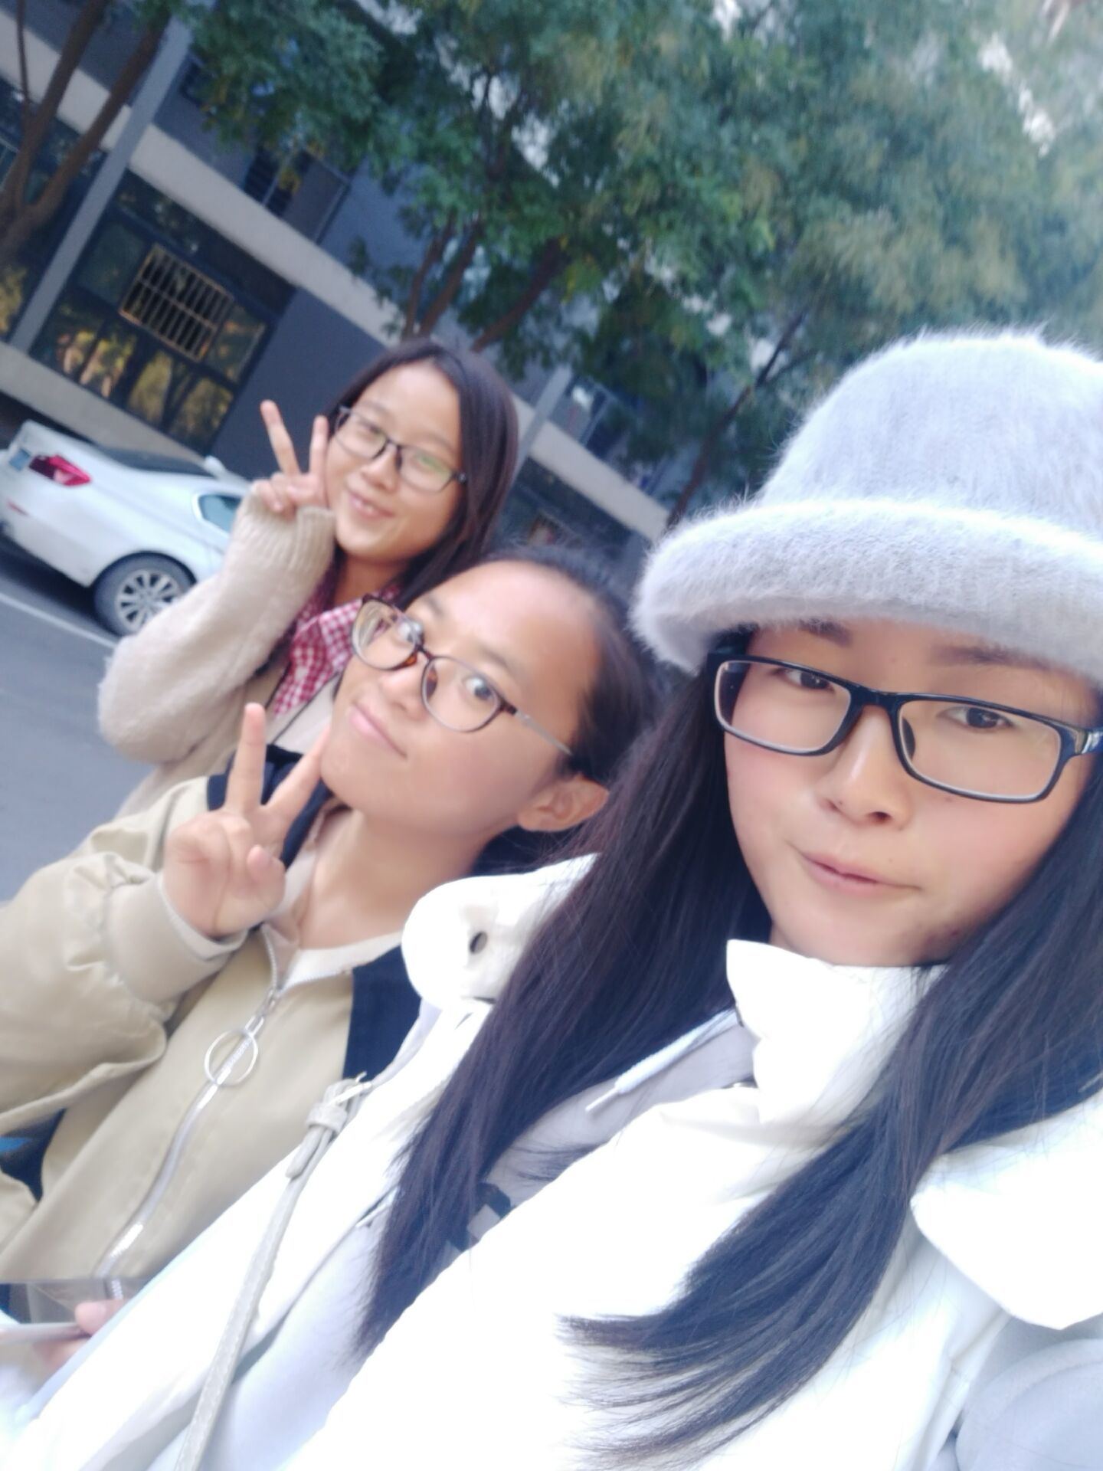
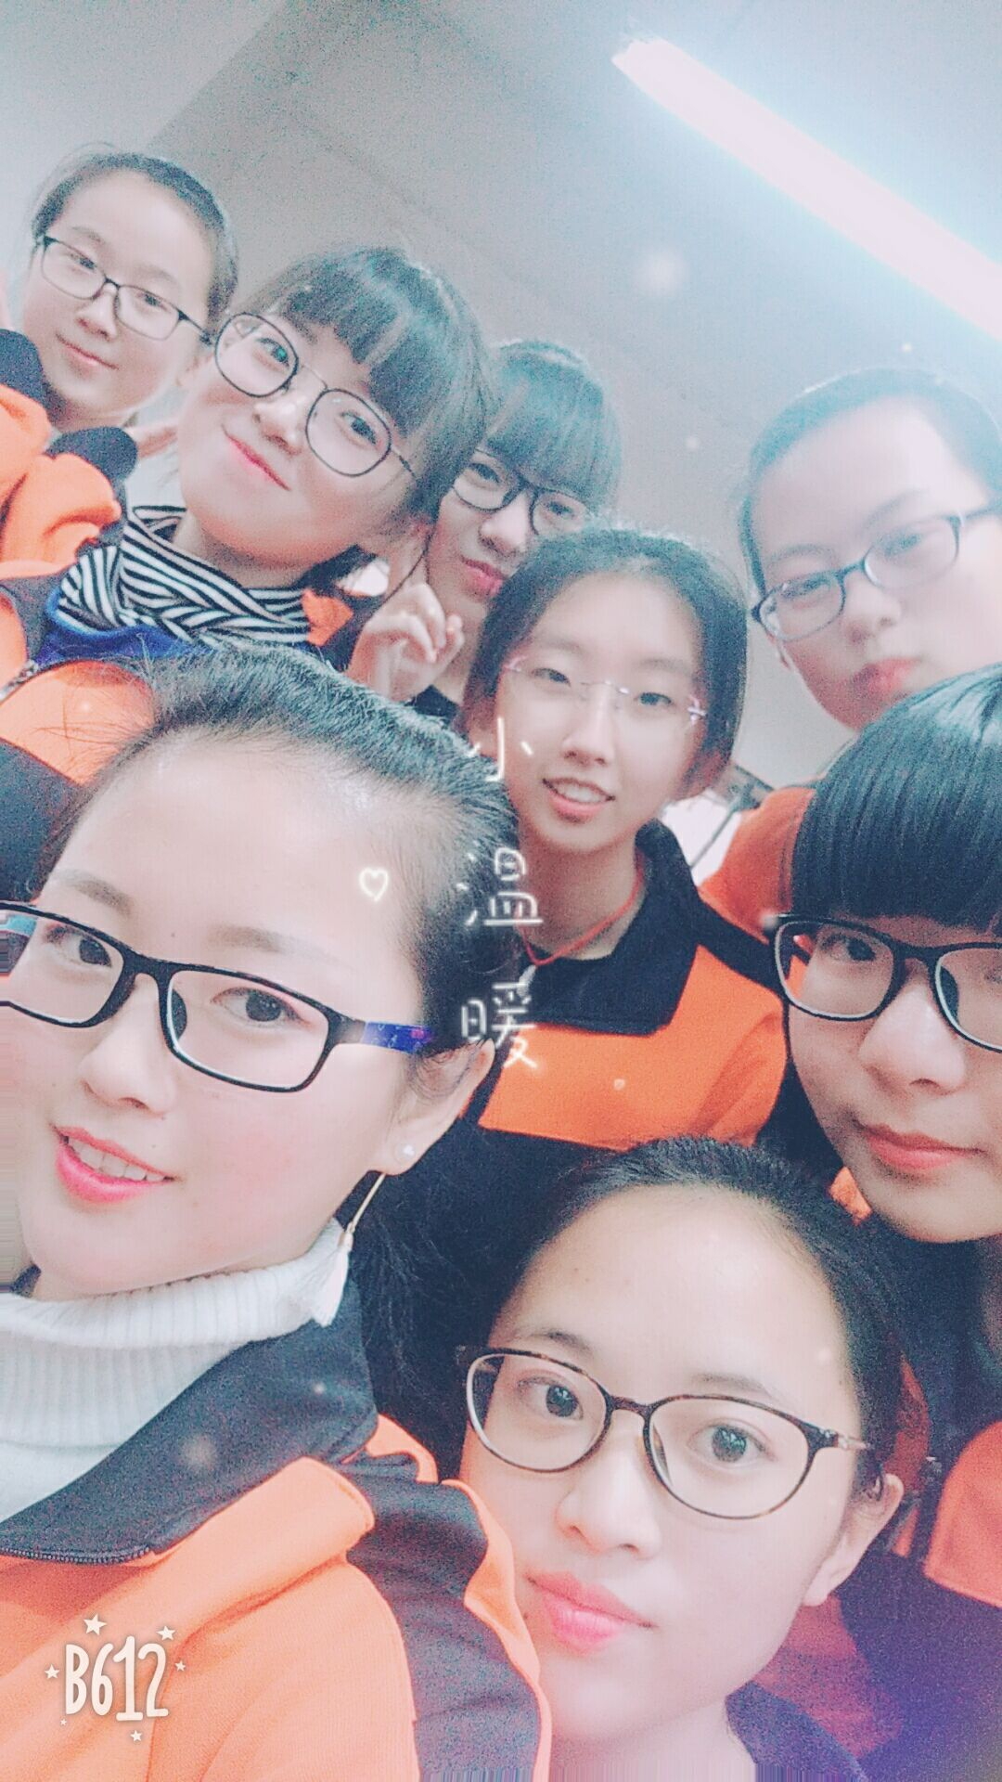
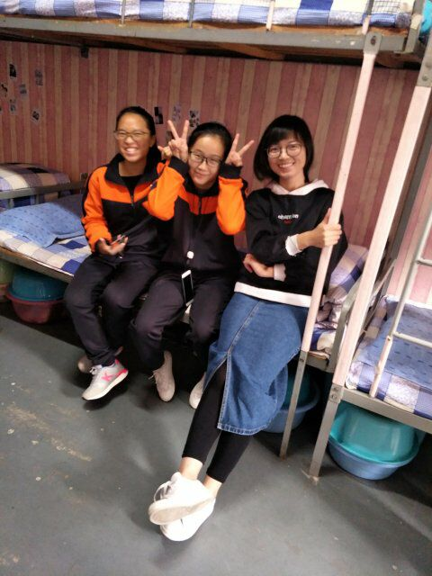
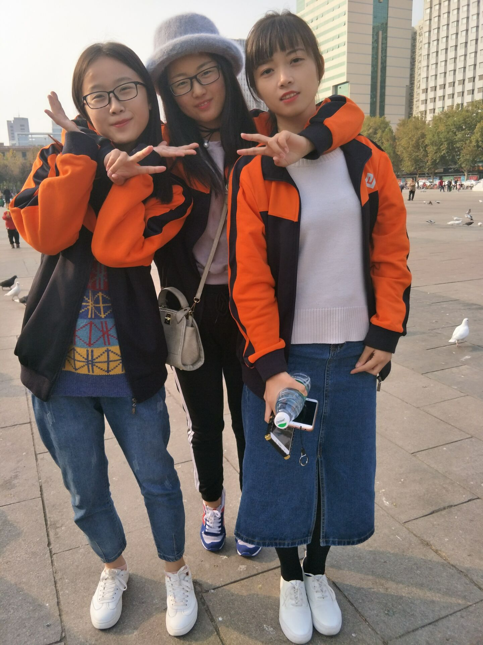
My friend
There are my friends.
(*^▽^*)

Slide 10
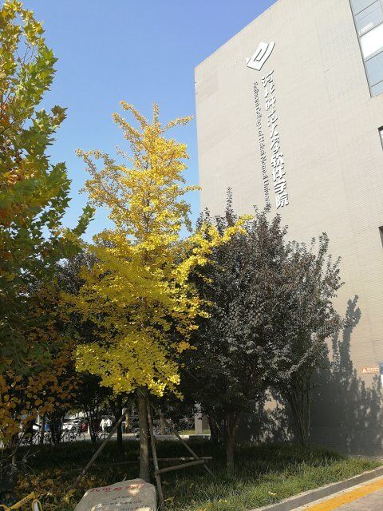
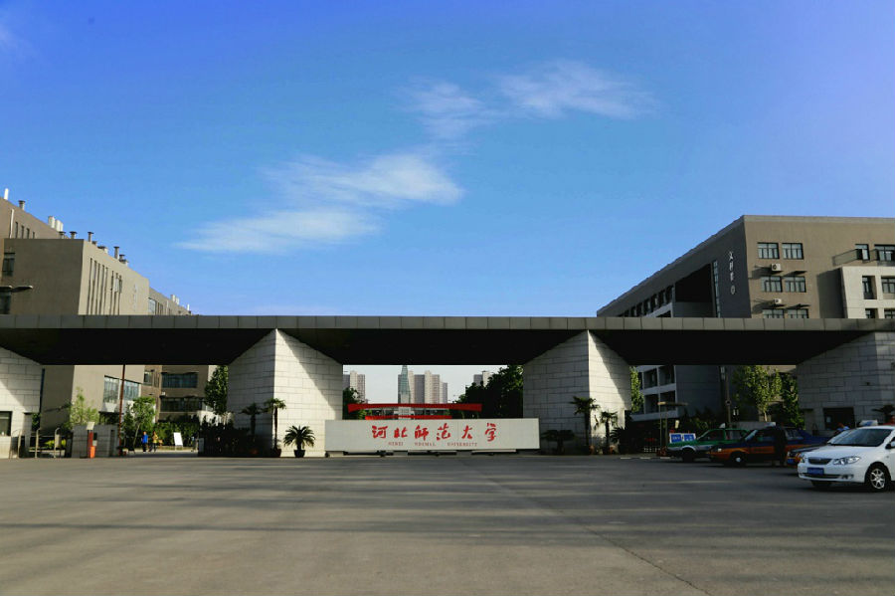
My major
I am studying in Software College of Hebei Normal University
(・｀ω´・)

Slide 11
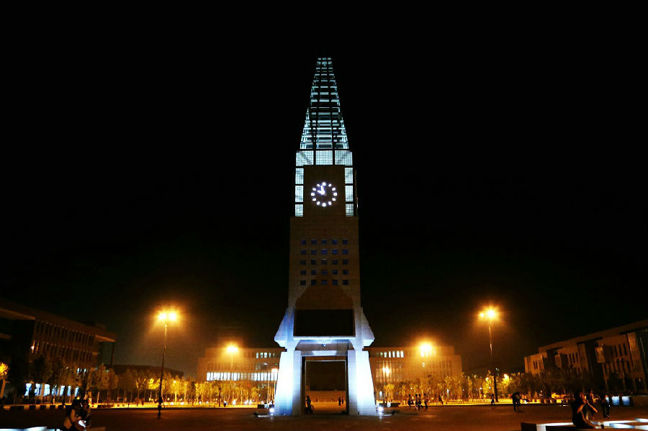
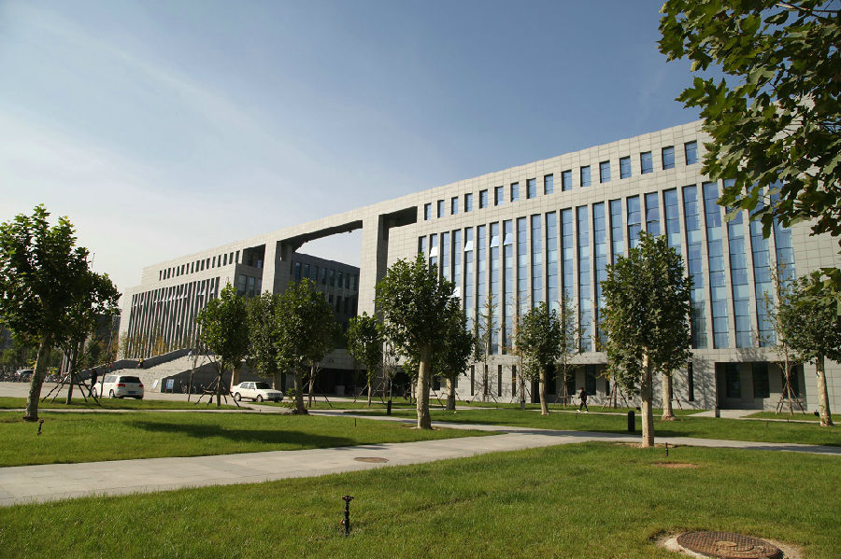
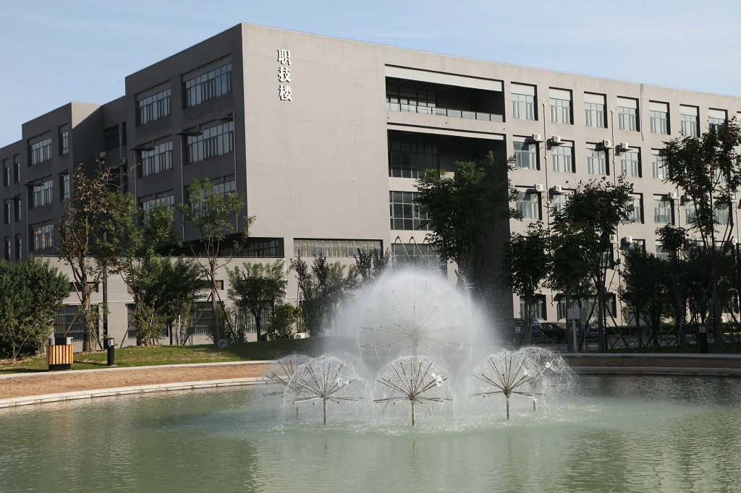
My major
Hebei Normal University is a very beautiful campus.

Slide 12
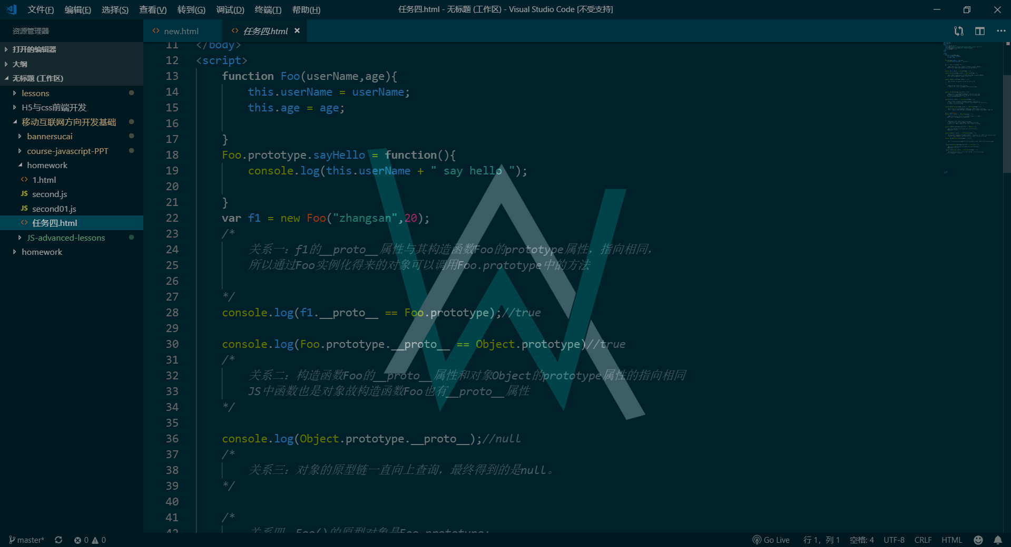
My major
My major is programming. I think it's a challenging profession.
It‘s tired, but I enjoy it.
I like to write web pages. Writing web pages is a very challenging and interesting thing.
(・｀ω´・)

Slide 13
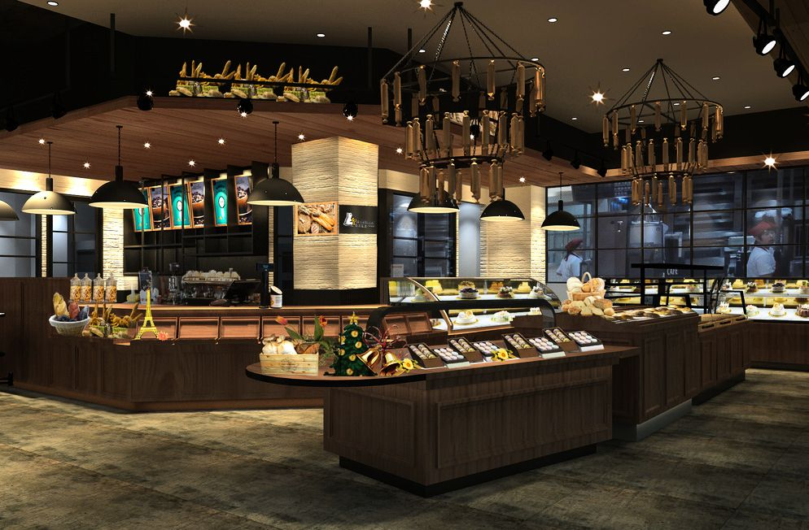
My dream one
That's my dream to be the manager of a bakery. I like dessert because it's a feeling of happiness from which I can harvest happiness.
(*￣∇￣*)

Slide 14

My dream two
I also want to be a teacher. I like children very much. Besides, teachers are a sacred profession.
(๑•ω•๑)

Slide 15
END
ヽ(^ω^)ﾉ

